Slide 1
Defect Programmer Assignment
Capgemini - Sprint 1
Group 3

Slide 2
The Project Idea
To develop a software that automatically assigns the defects reported by the client company to programmers depending on the functional area they are handling.
…..

Slide 3
Agenda
01 Time Consuming
03 More Labour
02 Not realtime
04 Less Efficient

Slide 4
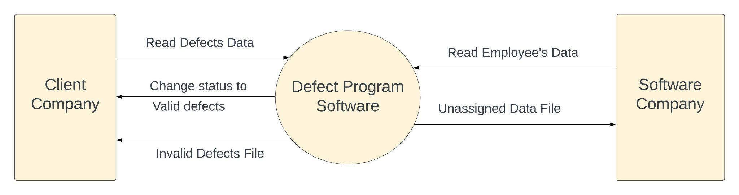
Data Flow Diagram
Level 0 DFD

Slide 5
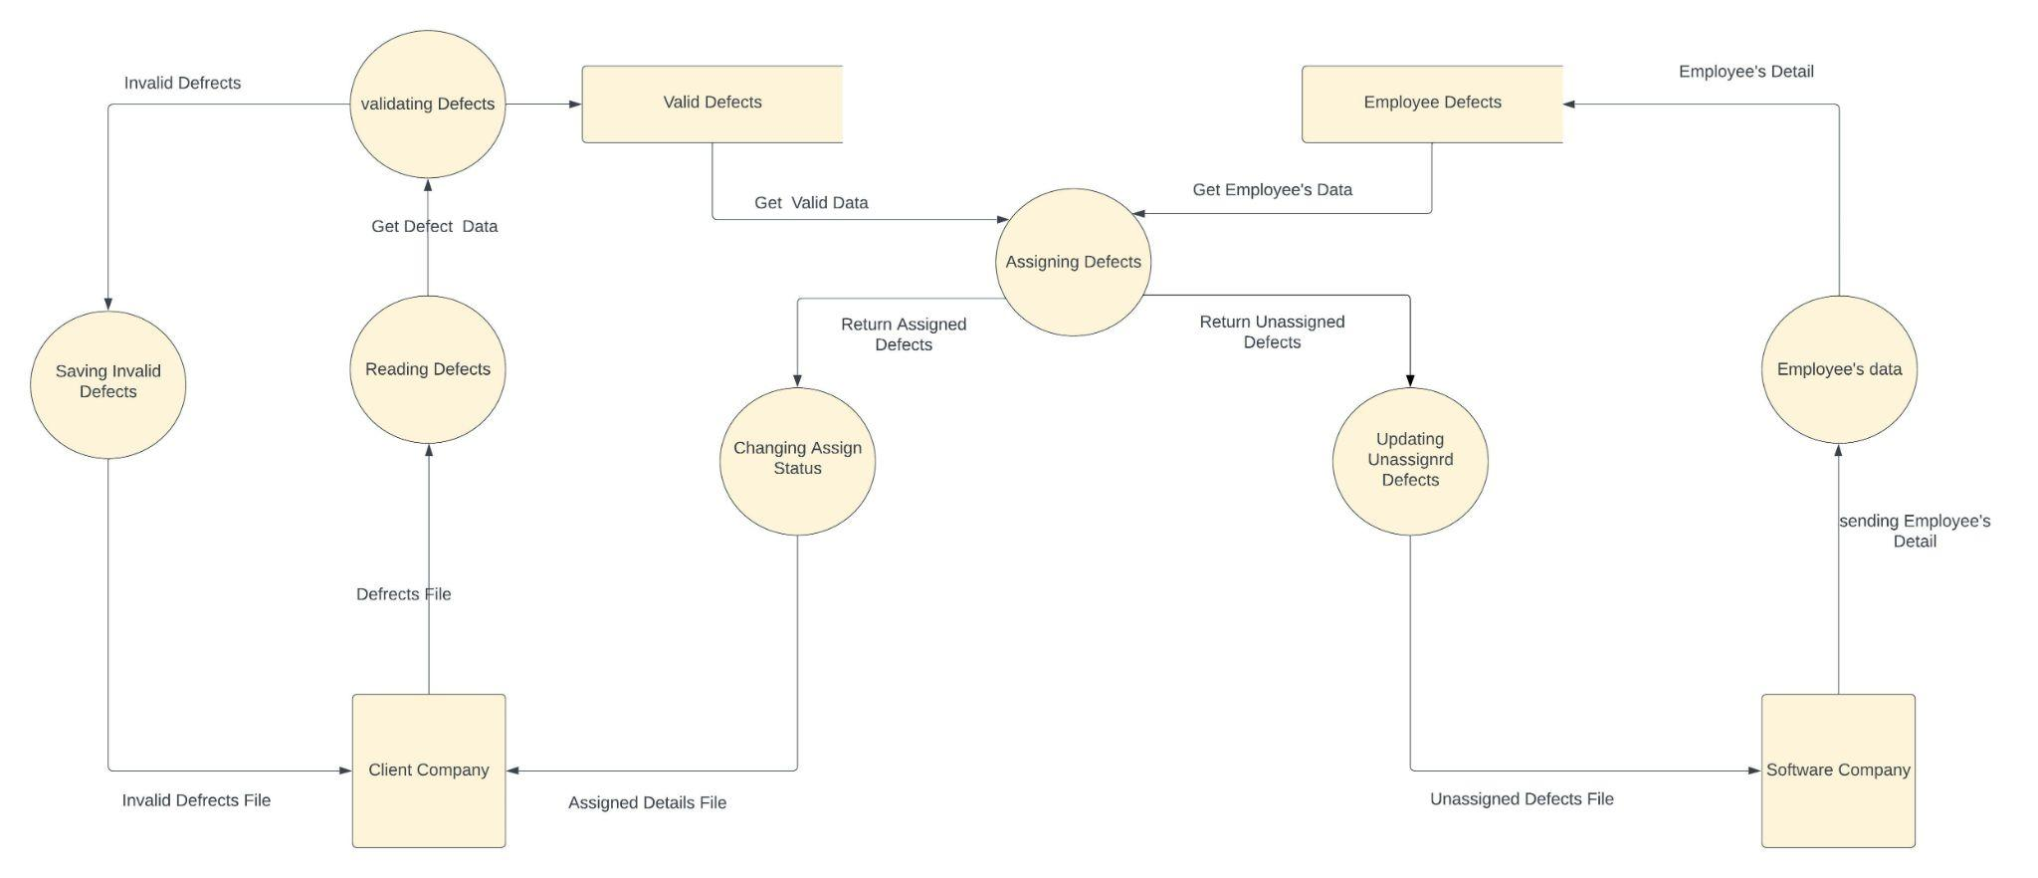
Data Flow Diagram
Level 1 DFD

Slide 6



Solution
Multi Threaded
Multi File
Modular

Slide 7
Program Flow
Multiple Defect Files
Employee Database
Unassigned Defect
Invalid Defect
Multiple Employee Assignment
.
Input Files
getDefect.c
Output files
1
2
3
4
5
main.c
assign.c

Slide 8
main.c

Slide 9
main()
Input Defect files are taken as command line arguments and also validates them
Separate threads are created for each input files and these files are passed to getDefect() function .
It calls getEmployee() function to fetch data from Employee database.
Finally it waits for all threads to complete their work.

Slide 10
getEmployee()
It opens “employee.txt” database file.
Now it reads the file line by line, each line contains information of one employee.
It stores this information inside Employee Structure.
Displays error if file can't be opened for any reason.

Slide 11
getdefect.c

Slide 12
Functions
Get Defect
Read the defects from the input and call assignEmployee() for valid defects
Check Validity
Return true for valid and false for Invalid defects
Valid defect
Store the valid defect in defect structure
Invalid Defect
Store the invalid data into invalidDefect.txt

Slide 13
1.GetDefect()
It reads the defect file from input file
After reading it call checkvalidity()
If true call validDefect() Else call invalidDefect()
It calls assignEmployee() for valid defect

Slide 14
2.CheckValidity()
it classify the defect data into valid or invalid type.
It tokenizes the defect data using strtok()
It increment the value of count for each attribute.
If count is equal to 7 it returns true
Else it returns false

Slide 15
3. ValidDefect()
If CheckValidity() return True the defect data is Valid defect
It tokenizes the string using strtok()
Dynamically allocates memory
Store valid defects into their respective attribute in defect structure

Slide 16
4. InvalidDefect()
If CheckValidity() return false the defect data is invalid
It display invalid defect message with defect id
Append the invalid defect data into invalidDefect.txt

Slide 17
Assign.c

Slide 18
Functions
1.assignEmployee()- Checks for defects with status as open.
2.unassignedDefect()- Copies all unassigned Defect into separate text file.
3.createEmployeeFile()- Creates separate files for each programmer who have at least one defect assigned to him
4.searchProgrammer()- Searches for programmer suitable of open defect.

Slide 19
1.assignEmployee()
It loops through all defects and checks their status.
If status is open then it calls searchProgrammer() Function.
Defects with any other status are ignored.

Slide 20
2.unassignedDefect()
Now it opens “uassignedDefect.txt” file and appends all information of current defect to the last line of the file.
If file is not present it creates a new one.
Displays proper error if there is any issue with opening or writing inside this file.

Slide 21
3.createEmployeeFile()
Creates separate file for each employee, if not present already, who have at least one defect assigned to them.
Filename:-<EmpID> _assignments.txt
Appends employee and defect information into the file.
Displays proper error if there is any issue with opening or closing of employee file.

Slide 22
4.SearchProgrammer():
1. For each defect (passed from assignProgrammer()), searches the array for a suitable programmer to assign the defect.
2. Condition for search:
Functional area of defect should match with the expertise of the programmer.
3. If a programmer is found then a mutex lock is created on the particular employee and createEmployeeFile() is called.
4. If no programmer is found then unassignedDefect() is called.

Slide 23
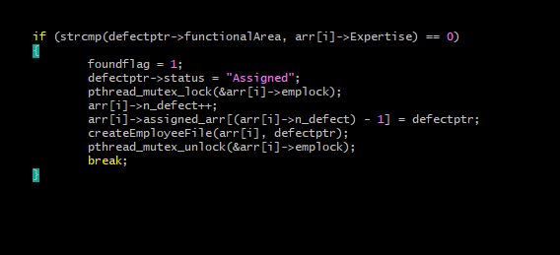
Mutex Lock:

Slide 24
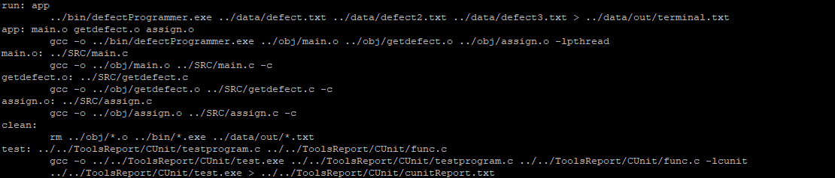
MakeFile

Slide 25
Testing
Unit testing and Integration testing

Slide 26
Different Types of Test Cases Covered
File is Empty or not Opening or Invalid file type
No Programmer is Found for Defect
Wrong Format of Defects or Employee in File
Less than or More than Actual Defect Attributes
Less than or More than Actual Employee Attributes

Slide 27
Test Suites
Sunny Test Cases:
"F001:Column values in BOM reports are incorrect:Aircraft design:BOM report:21/08/2022:open:fatal"
"N001:BOM report columns not alligned properly:Aircraft design:BOM report:21/08/2022:open:niceToHave"
"F002:Unit prices are not shown while preparing invoice:Invoices:Display products:23/04/2022:close:fatal"
Rainy Test Cases:
"ID01: : : ::open:"
"L001:Aircraft:BOM report:14/09/2022:open:niceToHave"
"R096:cliant dashboard are not shown:Aircraft design:dashboard"

Slide 28
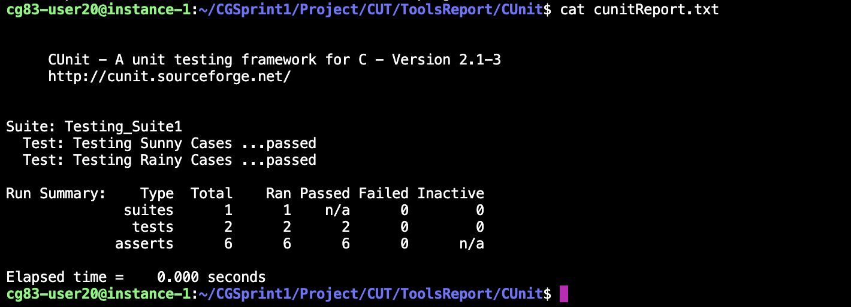
Unit testing for CheckValidity Function.
checkValidity()
It takes 1 argument that is: String pointer
It divides the string into tokens using strtok() and increment count for each.
If count is equal to 7 it returns True
Else it returns False.

Slide 29
Valgrind Report
==80999== Memcheck, a memory error detector
==80999== Copyright (C) 2002-2017, and GNU GPL'd, by Julian Seward et al.
==80999== Using Valgrind-3.16.1 and LibVEX; rerun with -h for copyright info
==80999== Command: make app
==80999== Parent PID: 80998
==80999==
==80999==
==80999== HEAP SUMMARY:
==80999== in use at exit: 147,994 bytes in 1,246 blocks
==80999== total heap usage: 2,072 allocs, 826 frees, 407,261 bytes allocated
==80999==
==80999== LEAK SUMMARY:
==80999== definitely lost: 0 bytes in 0 blocks
==80999== indirectly lost: 0 bytes in 0 blocks
==80999== possibly lost: 0 bytes in 0 blocks
==80999== still reachable: 147,994 bytes in 1,246 blocks
==80999== suppressed: 0 bytes in 0 blocks
==80999== Reachable blocks (those to which a pointer was found) are not shown.
==80999== To see them, rerun with: --leak-check=full --show-leak-kinds=all
==80999==
==80999== For lists of detected and suppressed errors, rerun with: -s
==80999== ERROR SUMMARY: 0 errors from 0 contexts (suppressed: 0 from 0)

Slide 30
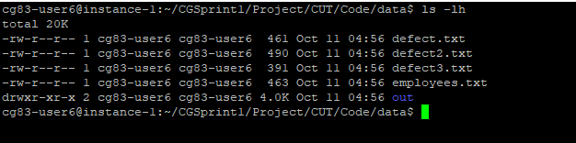
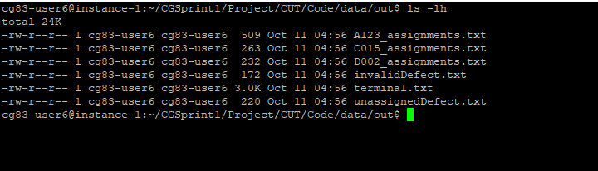
Integration Testing
Input Files
Output Files

Slide 31
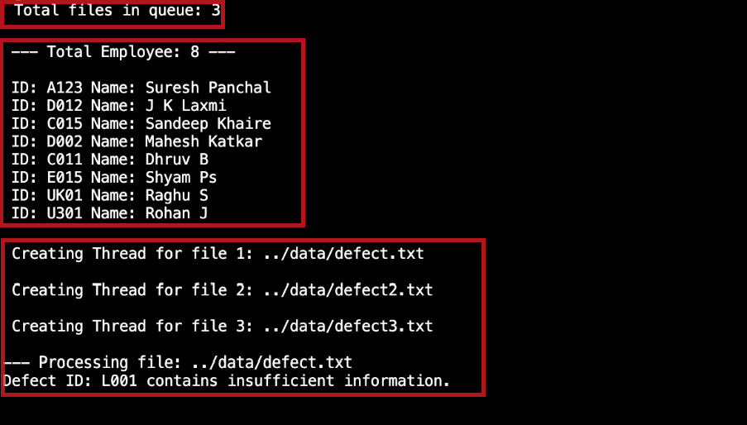
Contd..
1
2
3

Slide 32
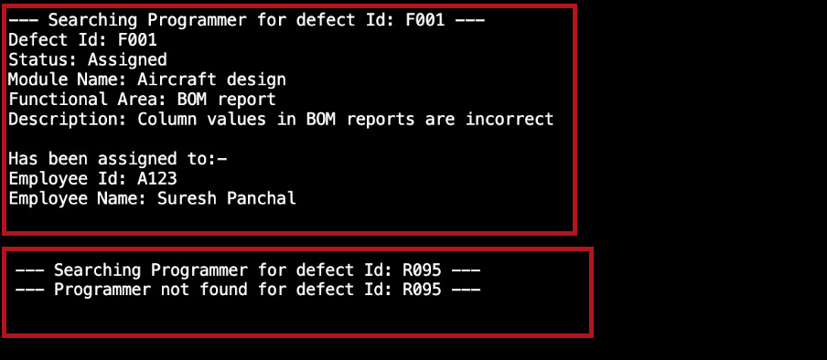
Contd..
4
5

Slide 33
Team CG83-Group 3
Sushant Kumar Singh
Egumamidi Sandeep Reddy
Gokul Krishna
Gundra Harshith reddy
Yuvraj C gadad

Slide 34
THANKS
Do you have any question?
Visit: https://github.com/HarshithReddy15/CGSprint1

